Slide 1
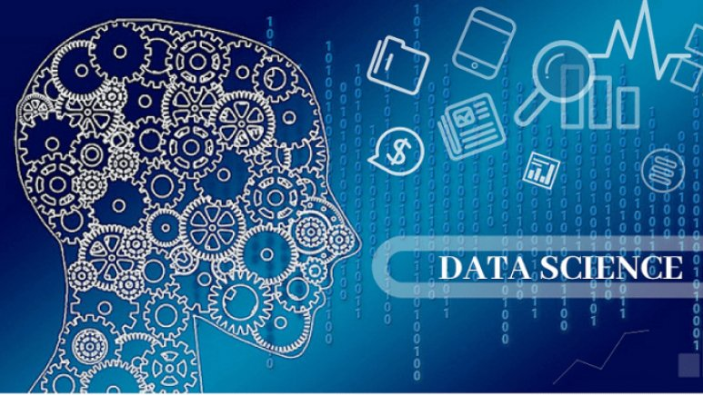
Data Science in Context By Nakyazze Pricilla Date: "2025-09-02"
This Photo by Unknown Author is licensed under CC BY-SA

Slide 2
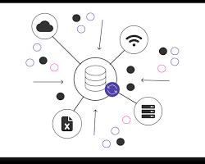
It's crucial to understand that data points by themselves are often meaningless. They gain value and utility only when they are understood within a broader context. This context provides the "who, what, where, when, why, and how" behind the data, which is essential for accurate analysis and ethical application
Data comes from A Data Source.
For e.g., a customer survey, a website's server logs, a medical sensor, Data Base entry. The source can influence the data's reliability, accuracy, and potential biases.

Slide 3
Data Collection Conditions, which is how data was collected might influence the data. We must ask ourselves, was it a controlled experiment or an observational study? Were there any external factors (like a major news event or a holiday)
It's important to consider the Purpose for originally collecting data. Data gathered for marketing purposes might have different features and biases than data collected for a scientific study. Using data for a purpose other than its original intent can be a major ethical issue.
For a data scientist, having domain expertise is critical. For a business, this could be understanding the company's goals, market, and customer base. For example, a data scientist working on a sales forecasting model needs to understand the business's product cycles, marketing campaigns, and competitive landscape.

Slide 4

Data Context in Higher Education
Student Performance and Success
Data on grades, attendance, and learning management system engagement can be used for more than just academic records. When put in context, this data can identify students at risk of dropping out and help academic advisors provide timely interventions. For example, a student with a sudden drop in a specific course's grade may need a targeted support session.

Slide 5

Admissions and Enrollment
Admissions data, including demographics, test scores, and application trends, is used to tailor recruitment strategies. However, this data must be used carefully. Relying too heavily on factors like ZIP code or high school GPA without considering other contextual information can perpetuate bias and lead to inequitable enrollment. Context is key to identifying and mitigating bias. An algorithm for college admissions might be biased if it's trained on historical data that favored certain demographics.
Curriculum and Academic Planning
Institutions use data to align their programs with the needs of the job market. By analyzing student outcomes and alumni employment data, universities can identify in-demand skills and adapt their curriculum to ensure graduates are workforce-ready. This also helps with resource allocation, such as deciding which departments need more funding or faculty.

Slide 6

Operational Efficiency
Data analytics helps universities manage their resources more effectively. By analyzing data from finance, human resources, and facility usage, institutions can streamline administrative tasks, optimize budgets, and improve campus-wide services.
Ethical and Privacy Considerations
The context of student data is particularly sensitive. Institutions must adhere to regulations like FERPA (Family Educational Rights and Privacy Act) and establish strong data governance frameworks. This includes being transparent with students about what data is collected and how it is used and ensuring that algorithms do not lead to biased or discriminatory outcomes in areas like financial aid or disciplinary action.
This Photo by Unknown Author is licensed under CC BY-NC-ND

Slide 7
Fairness, transparency, accountability, privacy, and causation
Data science presents several ethical considerations, including issues of fairness, transparency, accountability, privacy, and causation.
These principles are critical for ensuring that data is used responsibly and that data-driven systems do not cause harm. A very specific and interesting example of a data manipulation problem is the aspect of the IMDb reviews. The issue of a movie being review-bombed before it's even released is a significant and well-known challenge for IMDb and other review platforms. IMDb's official policy is that you cannot rate a title until it has had at least one public screening, which includes film festivals, limited releases, or official theatrical releases. But the option to rate a movie should only be made available after IMDb's system has a confirmed release date and made available to registered users who are not new members.
However, the reality is more complex, and this is where the "scandal" lies.

Slide 8
Orbitz an online travel company. A classic example of ethical issues in data science.
In 2012, it was widely reported that Orbitz was showing different hotel recommendations
to users based on the type of computer they were using. Specifically, the company found
that customers using Apple Mac computers were more likely to book higher priced hotels
and were also more likely to spend more per night on their stays.

Slide 9

Fairness
Fairness in data science means ensuring that algorithms and models do not perpetuate or amplify existing societal biases. Data sets often reflect historical and systemic prejudices related to race, gender, socioeconomic status, and other factors. If a model is trained on this biased data, it can lead to discriminatory outcomes. For example, a hiring algorithm trained on a biased dataset may unfairly screen out qualified candidates from certain demographics.
The goal of fairness is to build systems that provide equitable treatment and outcomes for all individuals and groups. The practice was seen by many as unfair. While Orbitz executives argued they weren't charging different prices for the same room, they were actively curating a more expensive set of options for a specific demographic. This raised questions about whether it was right to use a proxy for income (the type of computer) to influence a person's choices and potentially encourage them to spend more.

Slide 10
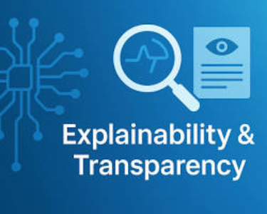
Transparency and explainability relate to the ability to understand how a data-driven system reaches its conclusions. Many advanced machine learning models, like deep neural networks, are considered "black boxes" because their decision-making processes are not easily decipherable by humans. This lack of transparency can be a problem in highstakes applications, such as medical diagnoses or credit approvals, where a person needs to understand why a certain decision was made.
Transparency is essential for building trust and allowing for human oversight and auditing of AI systems. Orbitz was not transparent about its practice. Users were not informed that their search results were being manipulated based on their operating system. This lack of transparency undermines consumer trust and prevents users from making informed choices. A simple linear regression might be more transparent and easier for stakeholders to understand than a deep neural network, which could be a "black box" solution. The level of transparency needed is a contextual choice.

Slide 11

Accountability
Accountability in data science refers to the responsibility for the outcomes and impacts of a data-driven system. When an algorithm makes a harmful or incorrect decision, it's crucial to know who is responsible. This can be complex, as it could involve the data scientist, the organization that deployed the model, or the company that provided the data. Establishing clear accountability mechanisms is essential for addressing harm, correcting errors, and ensuring compliance with regulations. The choice of metric (e.g., accuracy, precision, recall, F1 score) depends on the problem.

Slide 12

Privacy
The scandal highlighted the use of seemingly innocuous data like the type of device you're using to build a profile of a user's spending habits and preferences. This kind of data mining, which is now commonplace, raises significant privacy concerns about what information companies are collecting and how they are using it.

Slide 13
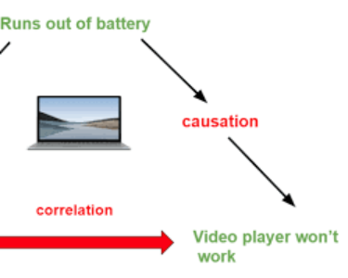
Causation
Causation is a central concept in data science that is often confused with correlation. Correlation simply means that two variables are related or move together. For example, ice cream sales and shark attacks may both increase in the summer, but one does not cause the other. Causation, however, means that a change in one variable directly causes a change in another. In data science, drawing causal conclusions from correlational data can lead to flawed and harmful decisions.
To establish causation, researchers often need to use more rigorous methods, such as controlled experiments or causal inference techniques, to prove a true cause-and-effect relationship. A common mistake is to confuse correlation with causation. Just because a model predicts a link between two variables (e.g., ice cream sales and shark attacks), it doesn't mean one causes the other. You must communicate this distinction clearly.

Slide 14

Conclusion
Raw data is often messy and may contain errors or missing values. Before analysis, tasks such as:
Handling missing values (e.g., using is.na() and na.omit()).
Converting data types (e.g., using as.numeric() or as.factor()).
Renaming columns for clarity (e.g., using rename() from the dplyr package)
Use functions like summary() and mean() to get a quick overview of variables like average grades or study hours.
Create plots to explore relationships and distributions. The ggplot2 package is a powerful tool for this.
Use of the cor() function to calculate the correlation between different variables, like the relationship between a student's previous grades and their final grade.
Use the lm() function to build a linear model that predicts a student's final grade based on a set of independent variables (e.g., study time, absences, and parental education level). The output of this model helps you understand which factors have a significant impact.
As Data scientists this serves as a cautionary tale about the fine line between providing a customized user experience and engaging in potentially discriminatory or manipulative practices because of the solutions we created. Solving data science problems effectively requires more than just technical skills, it demands a deep understanding of the context in which the problem exists. Without this context, you risk building models that are technically sound but practically useless or even harmful. By prioritizing context the role of a data scientist transforms from a technical expert into a strategic problem solver who creates impactful and ethical solutions.

Slide 15
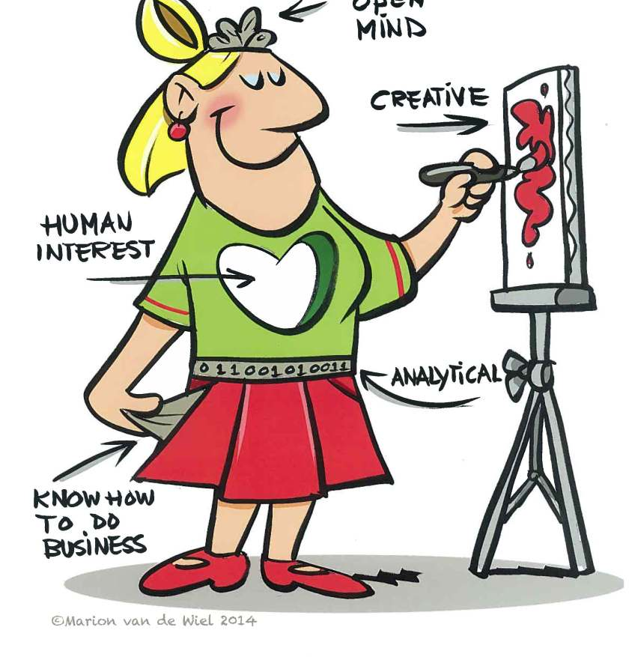
Data Science in Context. The end.
This Photo by Unknown Author is licensed under CC BY-SA-NC

